Slide 1


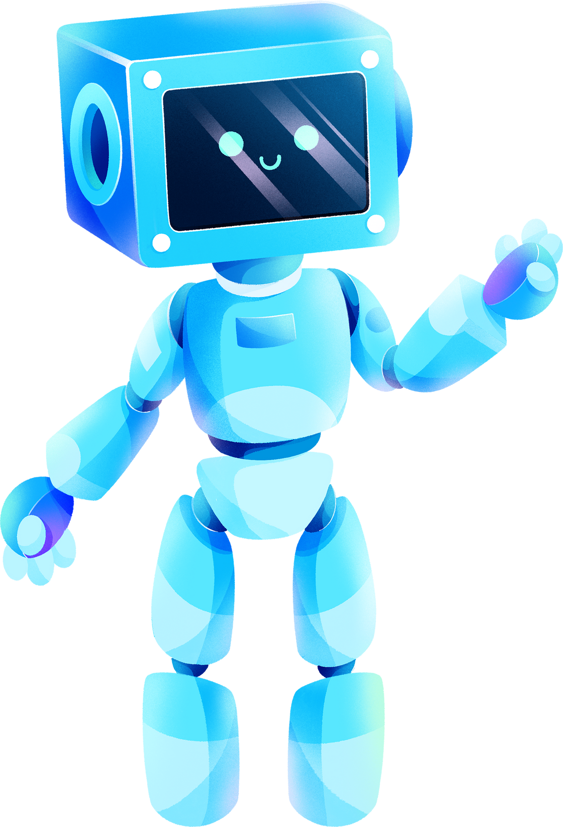
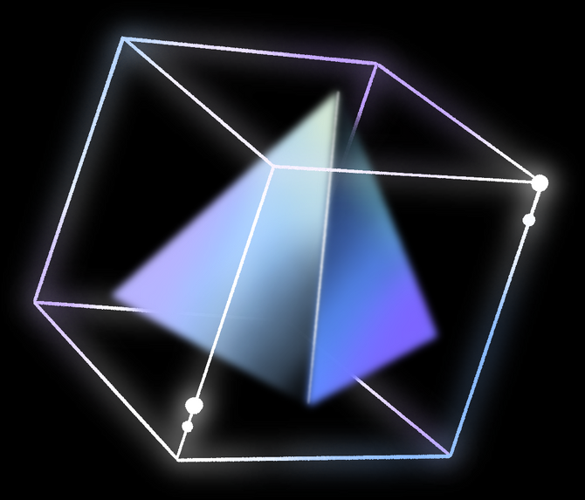
by
CHATBOT
BY
Y22IT092
Y22IT082
Y22IT090

Slide 2
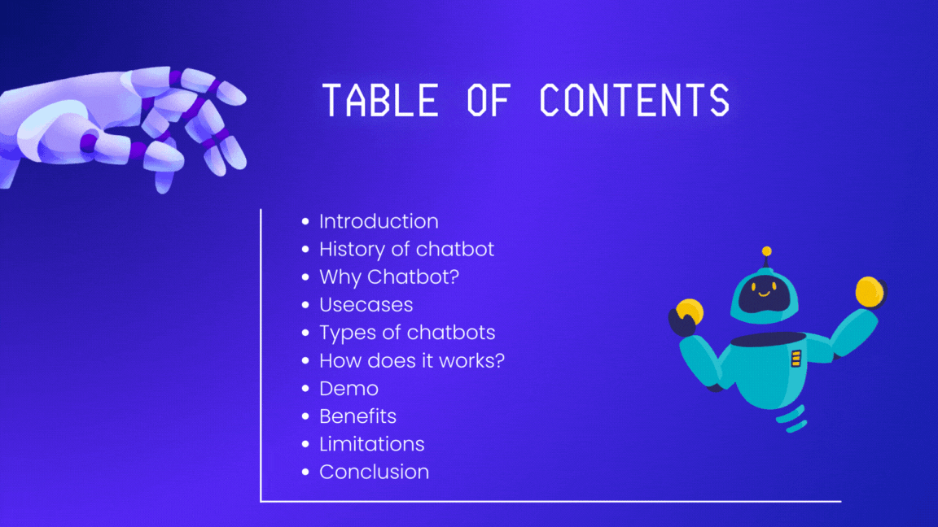
TABLE OF CONTENTS
Introduction
History of chatbot
Why Chatbot?
Usecases
Types of chatbots
How does it works?
Demo
Benefits
Limitations
Conclusion

Slide 3
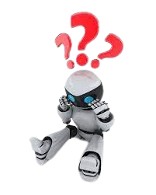

WHAT IS CHATBOT?
Chatbots are computer programs designed to simulate conversation with human users, especially over the internet.
It is a service , powered by rules and artificial intelligence, that you can interact with via a chat interface
A serivce could be any number of things , ranging from functional to fun, and it couls live in any major chat product(facebook messenger,Slack, Telegram,Text message,etc)

Slide 4
HISTORY
The first chatbot ever by developed by MIT Professor Joseph Weizenbaum In the 1960s it was called ELIZA. you’ II read more about ELIZA and other popular chatbots that were developed in the secong half of the 20th century later on.
In the year 2009 , a company called WeChat in china created a more advanced chatbot.Since its launch,wechat has conquered the hearts of many users who demonstrate and unwavering loyality to it. It is a highly thriving social media platform

Slide 5
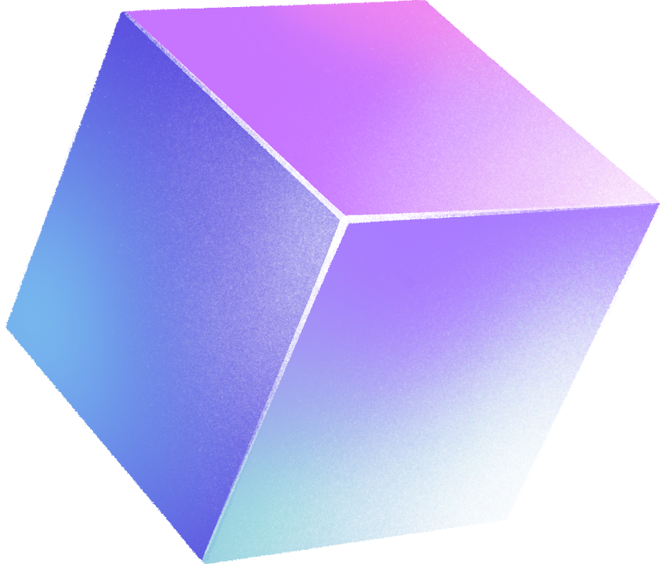
WHY CHATBOT?
24/7 Availability
Instant Responses
Cost-Effective
Scalability
Consistent Responses
Improved Customer Experience
Adaptability and Learning
Time and Resource Savings

Slide 6
USECASES
E-commerce
Scenario: An online store employs a chatbot to assist customers with product recommendations, order tracking, and FAQs.
Benefits: Improved shopping experience, personalized recommendations, and efficient order processing.
Healthcare
Scenario: A healthcare provider integrates a chatbot to schedule appointments, answer general health-related questions, and provide medication reminders.
Benefits: Enhanced patient engagement, appointment management, and accessibility to health information.
Education
Scenario: An educational institution employs a chatbot to answer student queries, provide course information, and offer study tips.
Benefits: Improved student engagement, instant information access, and automated administrative tasks.

Slide 7
Travel and Hospitality:
Scenario: A travel agency utilizes a chatbot to assist customers with flight bookings, hotel reservations, and travel recommendations.
Benefits: Streamlined booking processes, personalized travel suggestions, and instant travel-related information.
Marketing and Sales:
Scenario: A company employs a chatbot to engage with website visitors, qualify leads, and provide product information.
Benefits: Lead generation, personalized marketing, and improved conversion rates.
Insurance:
Scenario: An insurance company employs a chatbot for policy inquiries, claims processing, and providing insurance quotes.
Benefits: Faster claims processing, personalized insurance advice, and improved customer satisfaction.

Slide 8

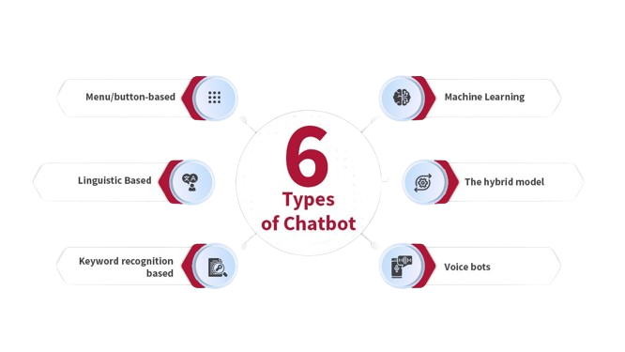



TYPES OF CHATBOT

Slide 9
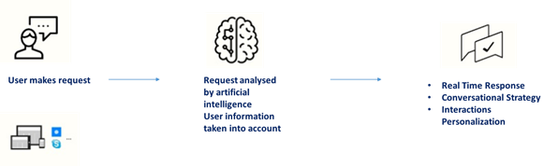

HOW DOES IT WORKS?

Slide 10

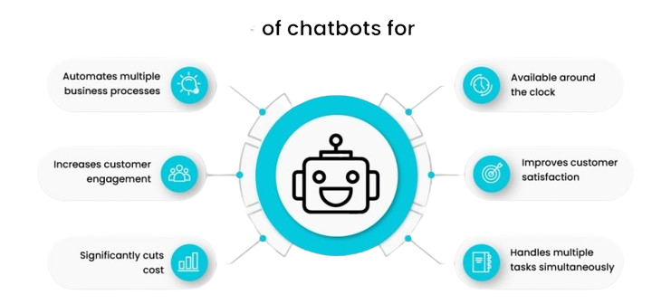
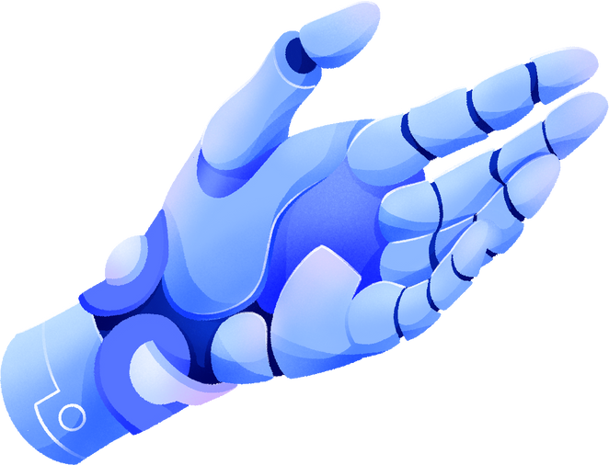
BENEFITS

Slide 11
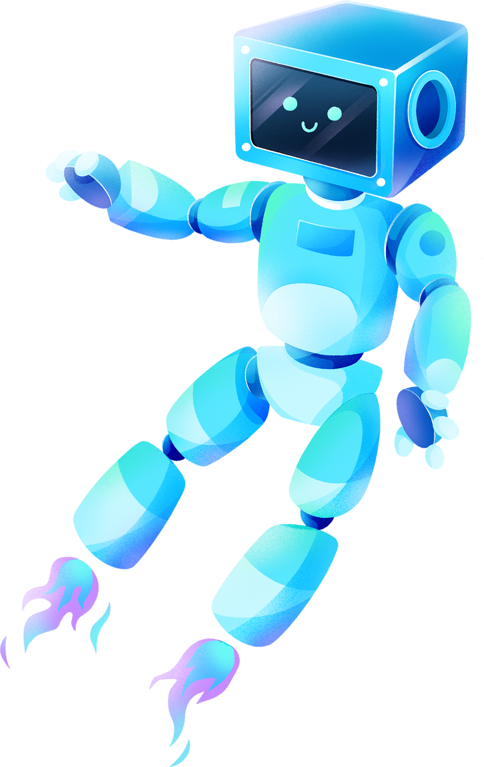
LIMITATIONS
Limited Understanding of Context
Dependency on Training Data
Inability to Handle Unstructured Inputs
Lack of Emotional Intelligence
Privacy Concerns
Initial Setup and Development Costs
Ethical Considerations

Slide 12
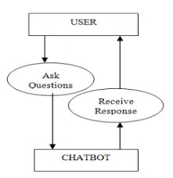
USECASE DIAGRAM

Slide 13





CODE EXPLANATION

Slide 14
DEF GREET(BOT_NAME, BIRTH_YEAR):
PRINT("HELLO! MY NAME IS {0}.".FORMAT(BOT_NAME))
PRINT("I WAS CREATED IN {0}.".FORMAT(BIRTH_YEAR))
EXPLANATION
DEF GREET(BOT_NAME, BIRTH_YEAR):: THIS LINE DEFINES A FUNCTION CALLED GREET THAT TAKES TWO ARGUMENTS: BOT_NAME AND BIRTH_YEAR.
PRINT("HELLO! MY NAME IS {0}.".FORMAT(BOT_NAME)): THIS LINE PRINTS A MESSAGE "HELLO! MY NAME IS {0}." WHERE {0} IS REPLACED WITH THE VALUE OF THE BOT_NAME ARGUMENT. THE .FORMAT(BOT_NAME) TELLS PYTHON TO INSERT THE VALUE OF BOT_NAME INTO THE STRING AT THE PLACEHOLDER "{0}".

Slide 15
def remind_name():
print('Please, remind me your name.')
name = input()
print("What a great name you have, {0}!".format(name))
Explanation
The above code defines a function called remind_name that attempts to:
Prompt the user for their name by printing "Please, remind me your name."
Read the user's input and store it in the variable name.
Print a message "What a great name you have, {0}!" where {0} is replaced with the value of the name variable.

Slide 16
def guess_age():
print('Let me guess your age.')
print('Enter remainders of dividing your age by 3, 5 and 7.')
rem3 = int(input())
rem5 = int(input())
rem7 = int(input())
age = (rem3 * 70 + rem5 * 21 + rem7 * 15) % 105
print("Your age is {0}; that's a good time to start programming!".format(age))
Explanation
This code defines a function called guess_age that attempts to guess the user's age based on the remainders obtained when their age is divided by 3, 5, and 7.

Slide 17
def count():
print('Now I will prove to you that I can count to any number you want.')
num = int(input())
counter = 0
while counter <= num:
print("{0} ".format(counter))
counter += 1
Explanation
This code defines a function named count that allows users to specify a number and then counts up to that number.

Slide 18
def test():
print("Let's test your programming knowledge.")
print("Why do we use methods?")
print("1. To repeat a statement multiple times.")
print("2. To decompose a program into several small subroutines.")
print("3. To determine the execution time of a program.")
print("4. To interrupt the execution of a program.")
answer = 2
guess = int(input())
while guess != answer:
print("Please, try again.")
guess = int(input())
print('Congratulations, your answer is correct!')
print('.................................')
Explanation
This code defines a function named test that quizzes the user on the purpose of using methods in programming.

Slide 19
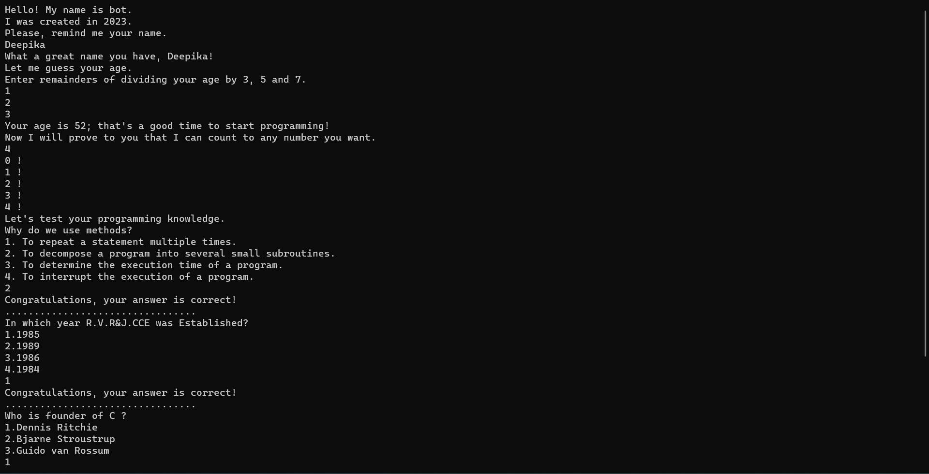

Slide 20
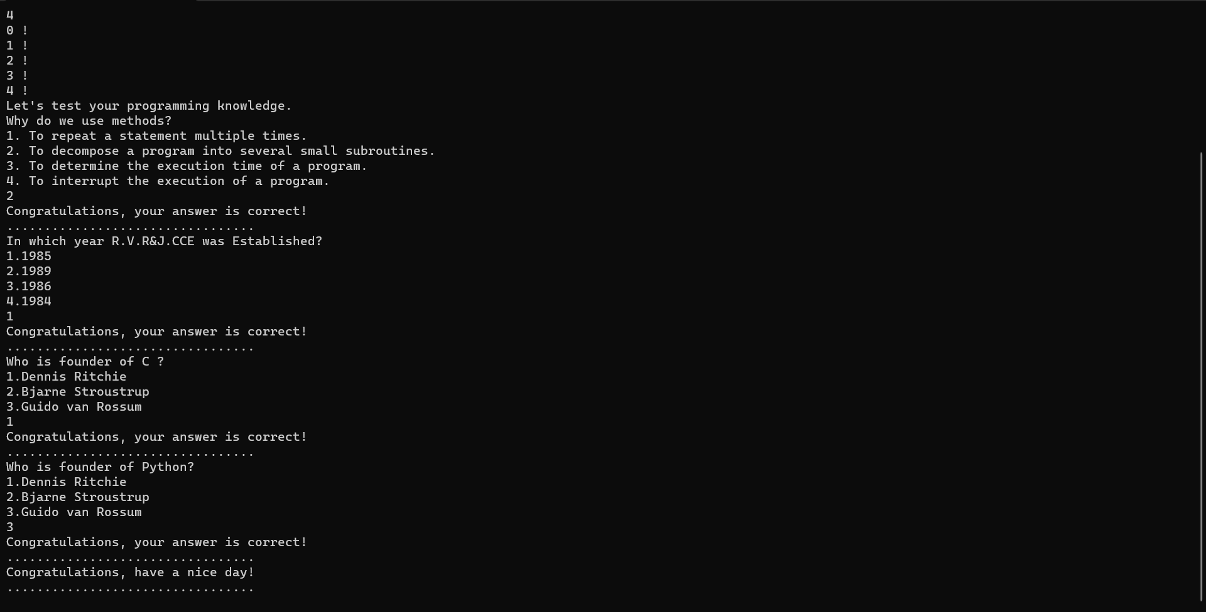

Slide 21
CONCLUSION
A chatbot is one of the simple ways to transport data from a computer without having to think for proper keywords to look up in a search or browse several web pages to collect information

Slide 22
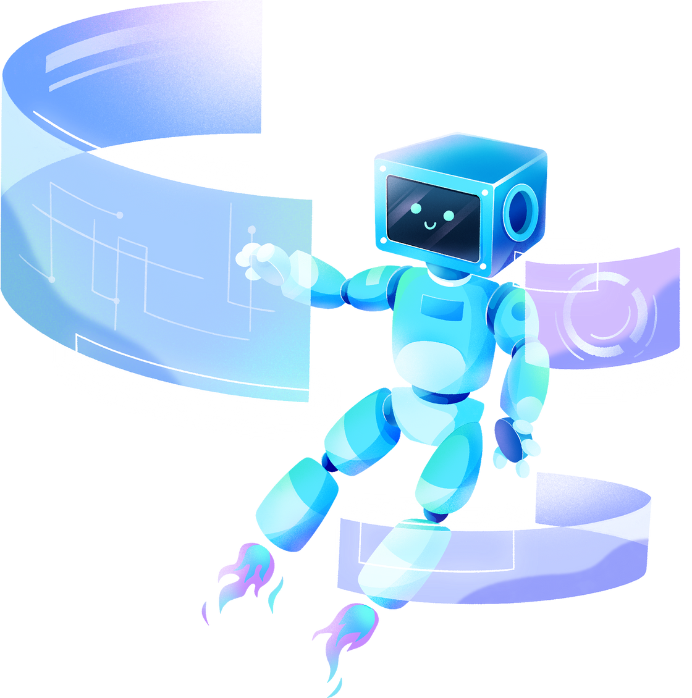
THANK YOU!

